Slide 1

E-commerce Website with Recommendation System

Slide 2
Project analysis slide 3
Project Plan
Project
Introduction
Conceptual study
Recommendation system
Website Application
We will give a general idea about the project structure
We will present our database designing with some diagram we used
We will see the type and importance of the RS we used in our project
We will show you some pictures from our website

Slide 3

Introduction
Recently, e-commerce platform is playing an important role in some areas; its activities are a subset of e-business activities.
So in this project we build and develop a reliable website using many existing web technologies, this website will be an online shop of our professor’s workshop based on e-commerce theories, integrated with a recommendation system which is one of the major sources for generating revenue in different online companies.
We tried to make it easy-to-use from the registration step to the payment, all this was based on a well-studied plan.

Slide 4
Requirement gathered
In our website we’ll have two types of users, the first type is the customer who’s can be either a new one or a registered one that already have an account made up with a unique id for identifying him among other users, a username, an email address, a password, phone number and his Address,
So he just have to login every time he want to access to our website or logging out in case that’s already logged. In the other hand the new user can browse and check products and see the popular or the most selled products in our website but he can’t make any purchase until he register.
Customer, either by searching or by the help of a recommendation system which will suggests products for him based on his similarity with other users. he can check and then order one product or more in a given date, each product belongs to a given category, and have as well an unique number , a name , a picture , a price and a text that describe his properties , each order have an unique id and a price that’s made up of all ordered products prices.
And because the costumer opinion is important for us we handle his rates for our products and give him the privileges to show us his thoughts about our products by writing commentaries. And finally the second type of our website user is made for the administration purpose called the super user or the admin who have a few information for logging into the admin space and manage the website’s components, such adding, deleting and updating products or checking customer’s reviews, orders.

Slide 5
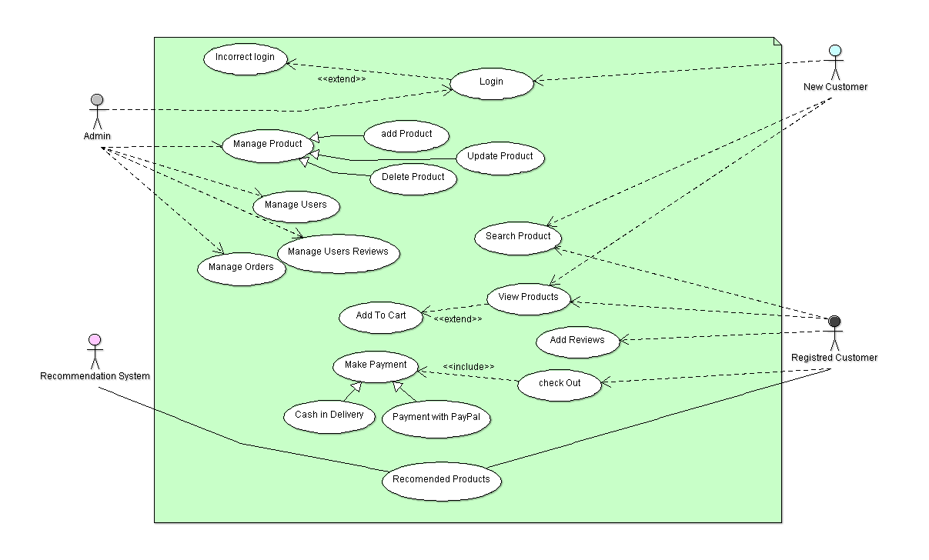
Use Case Diagram

Slide 6
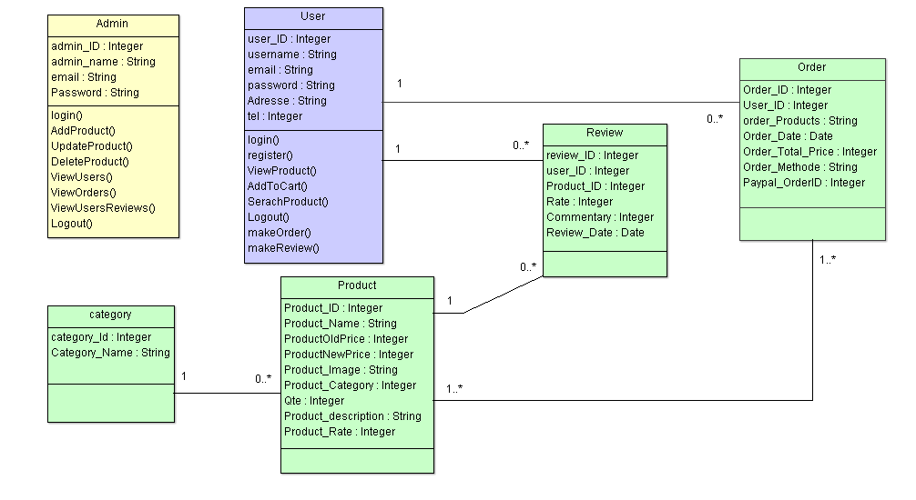
Class Diagram

Slide 7
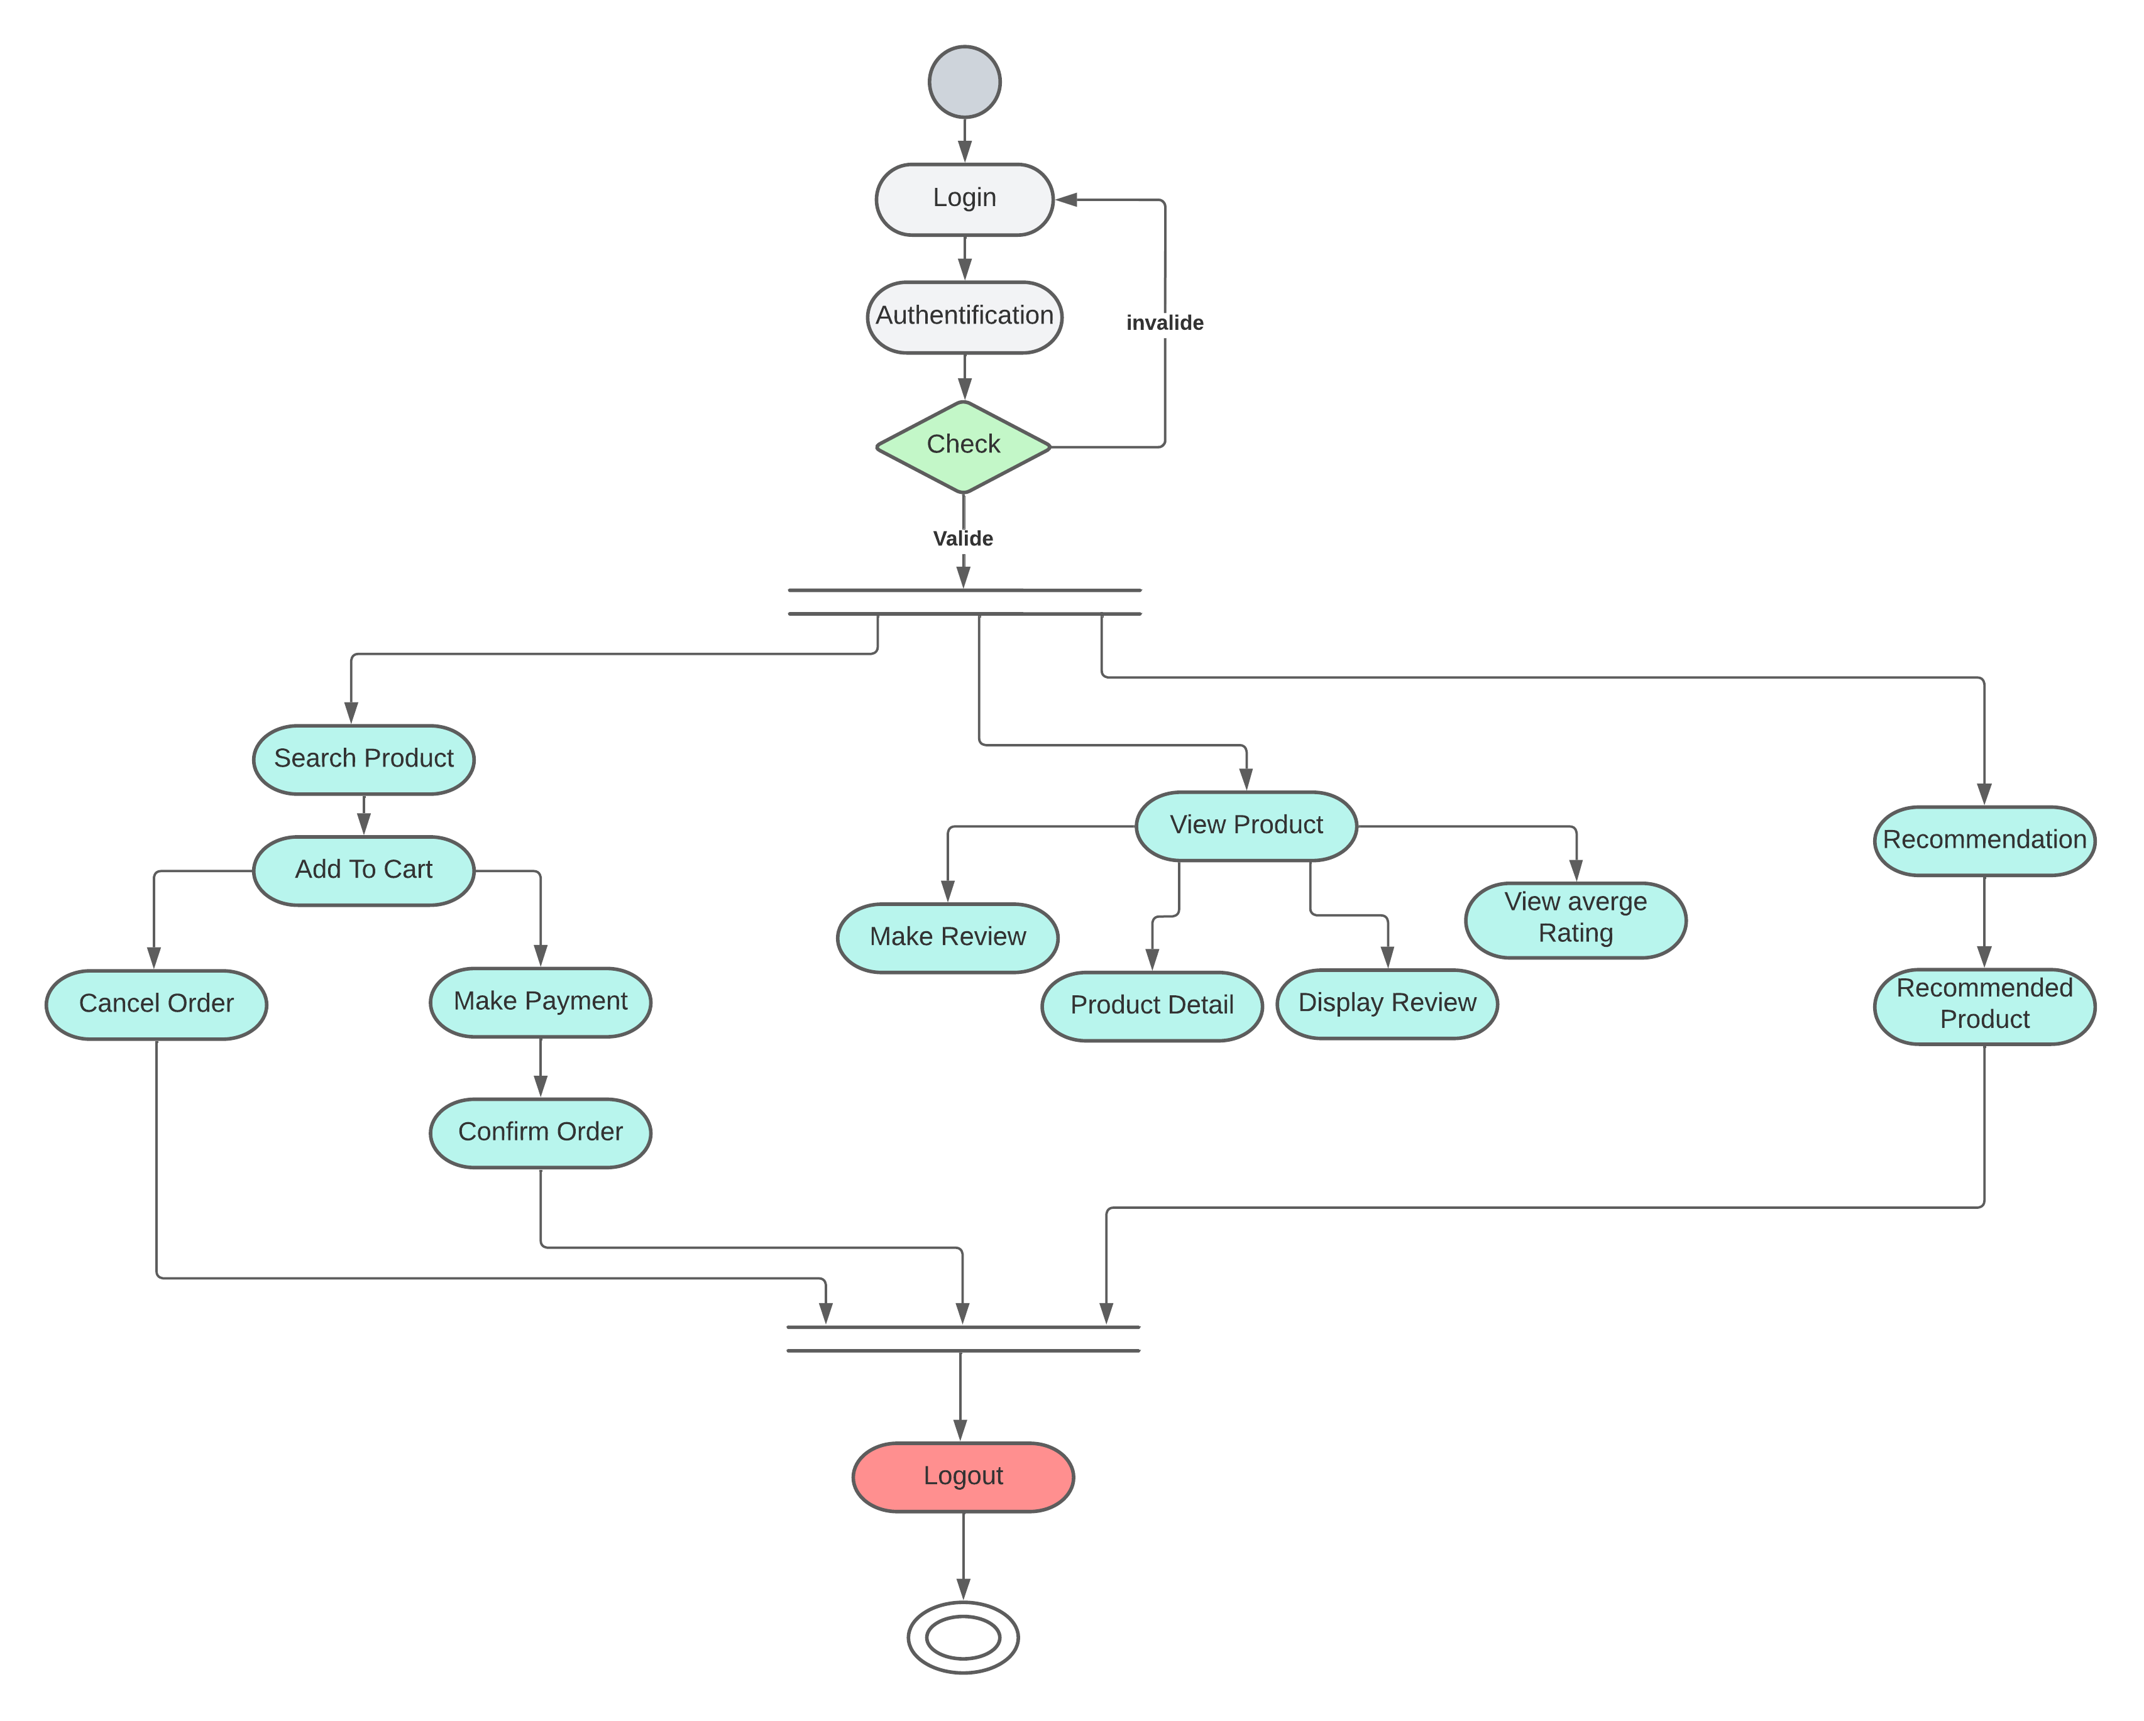
ActivityDiagram for user

Slide 8
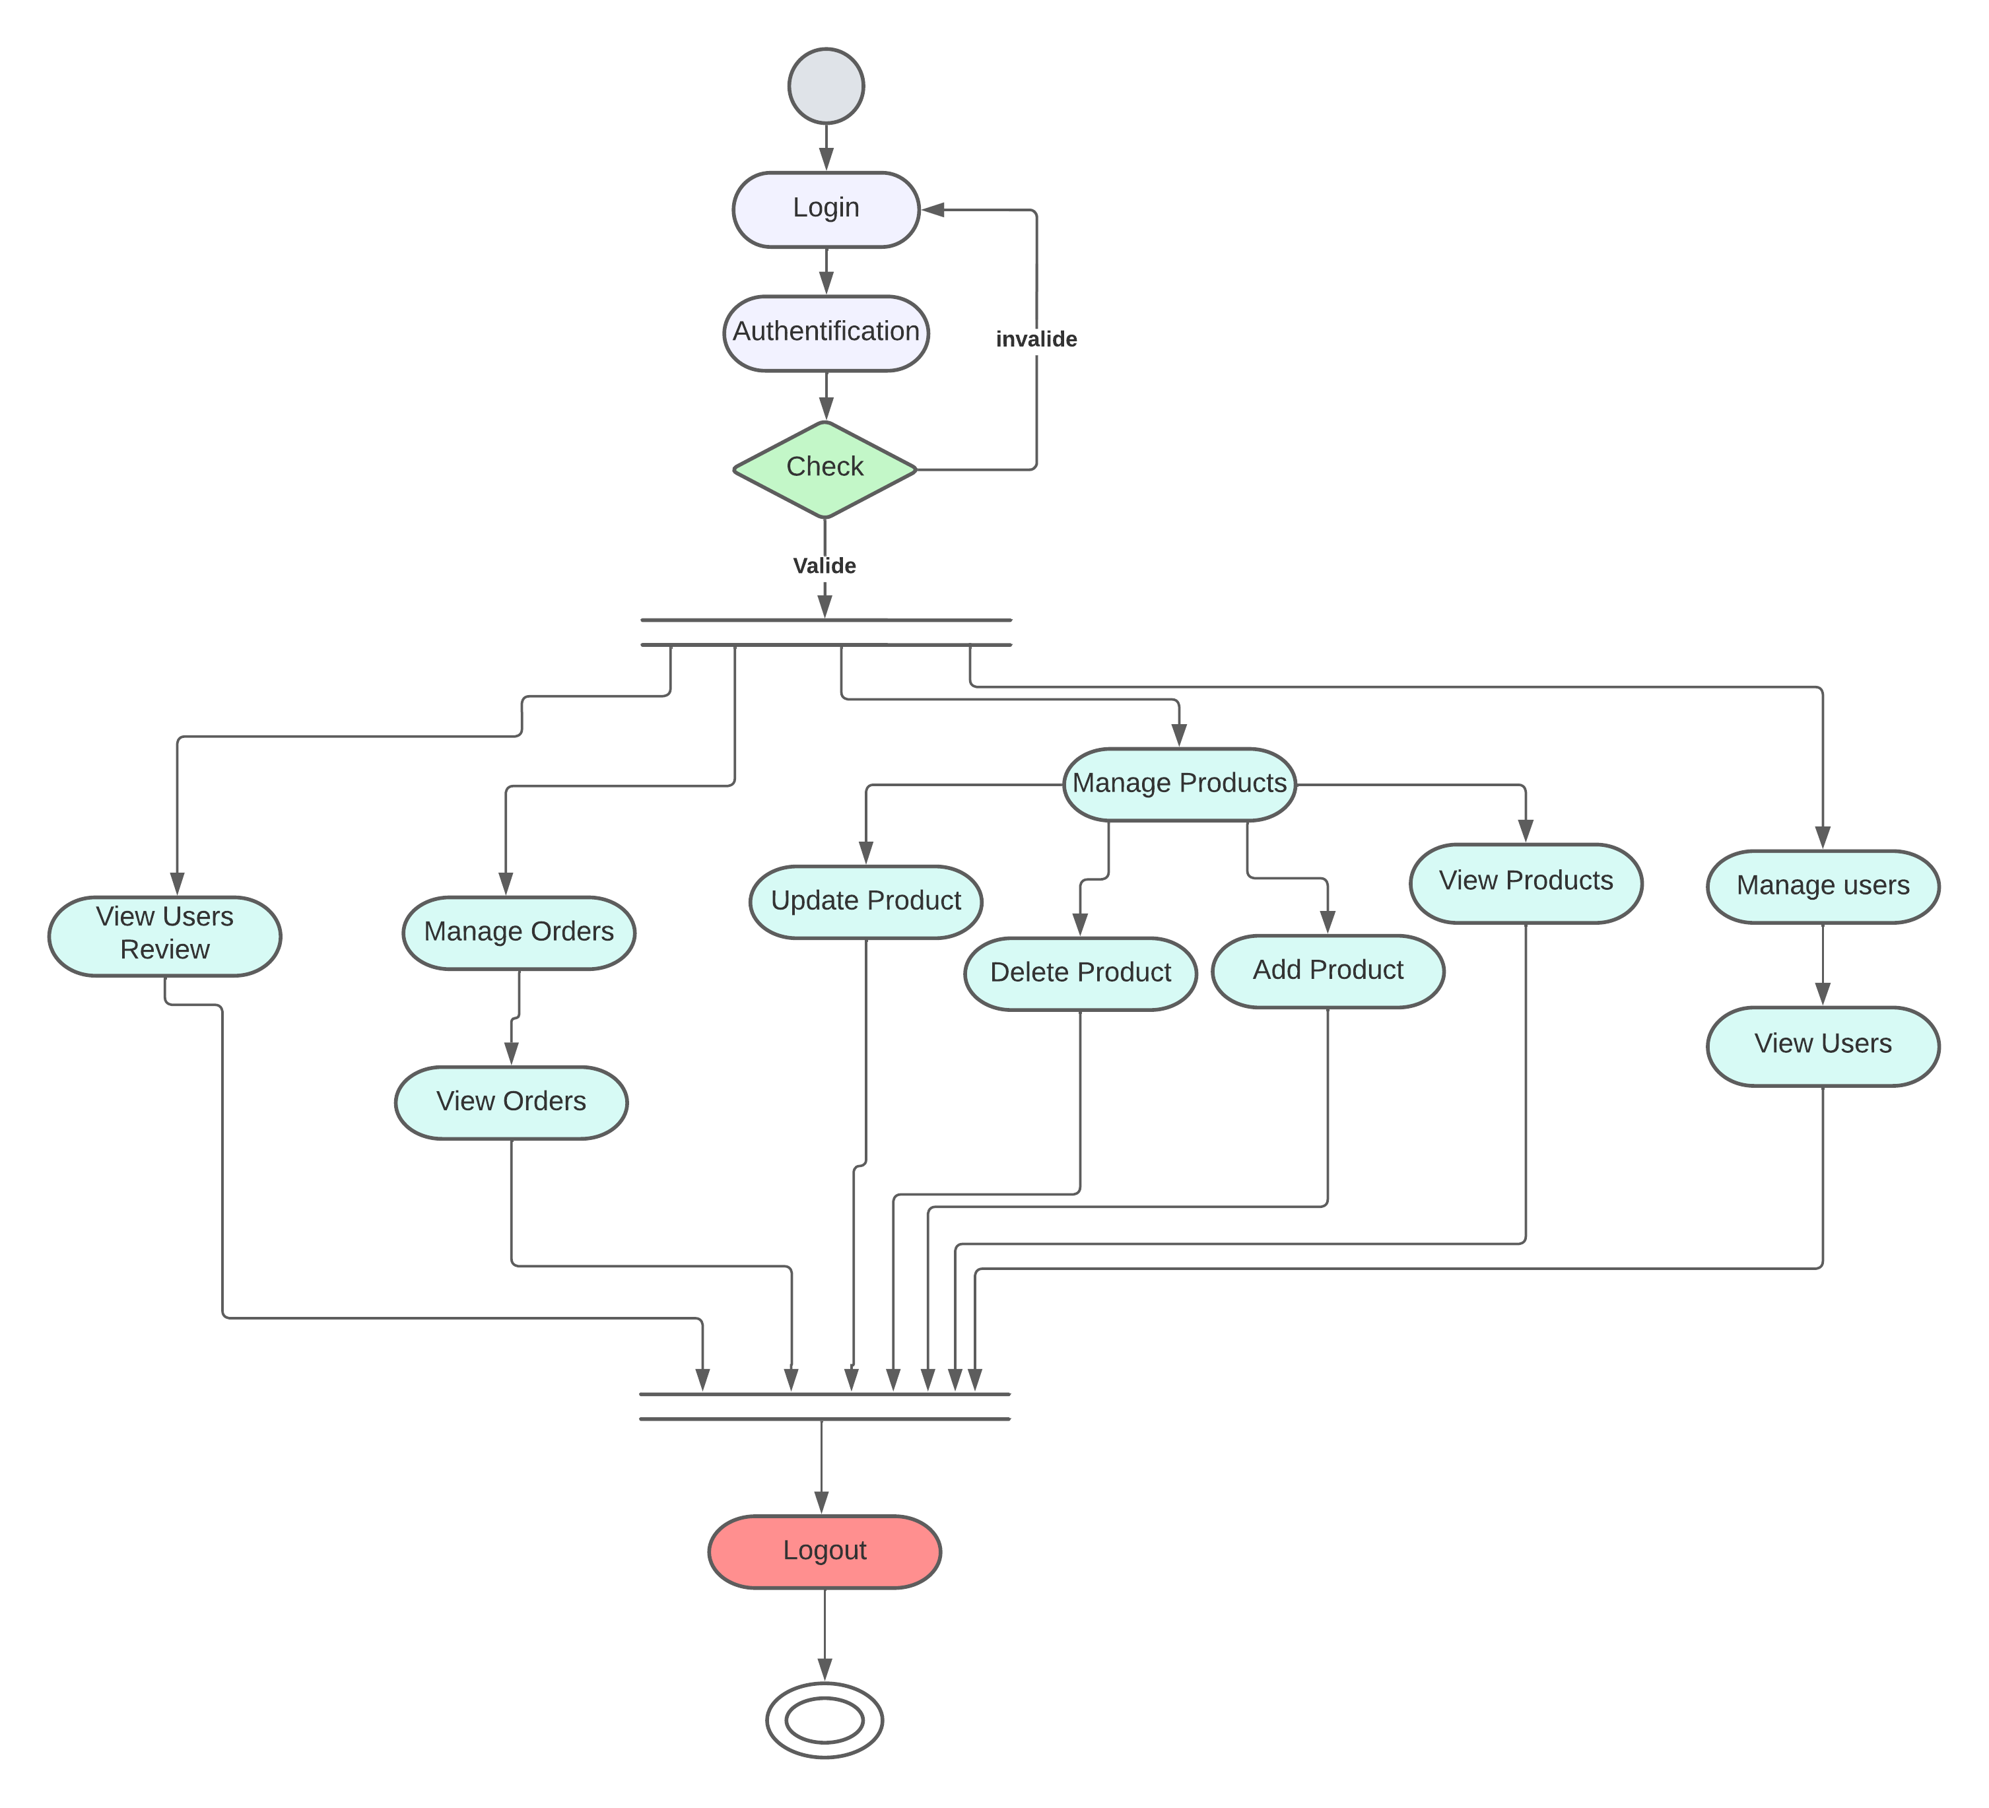
ActivityDiagram for Admin

Slide 9
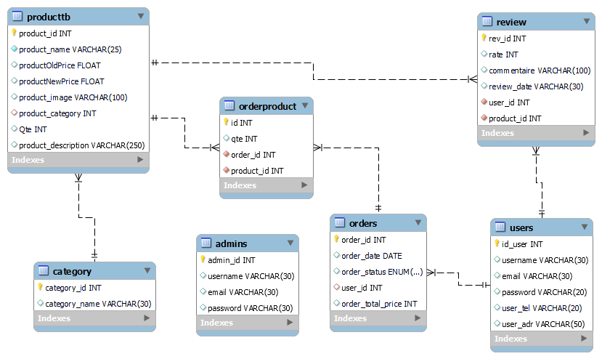
Relational Model

Slide 10

Recommendation System
What’s the recommandation system?
Recommender systems are the systems that are designed to recommend things to the user based on many different factors. These systems predict the most likely product that the users are most likely to purchase and are of interest to. Companies like Netflix, Amazon, etc. use recommender systems to help their users to identify the correct product or movies for them.
Recommendation system in Ecommerce Industry.
Recommendation engines is totally transforming or reshaping ecommerce industry by helping the customer to choose the relevant product. Recommendation system allows to increase the figures of sells, to offer more varied products, to improve user satisfaction and to fully consider customer needs. In simplest term recommendation engines are the ranked list of products to the user based upon different factors like user’s preference and constraints.

Slide 11
Collaborative filtering (the type we used in our website).
Collaborative filtering is based on the idea that similar people (based on the data) generally tend to like similar things. It predicts which item a user will like based on the item preferences of other similar users.
There’s two approaches for apply this type ; Item to item collaborative filtering & User to user collaborative filtering
User to user collaborative filtering : is a technique used to predict the items that a user might like on the basis of ratings given to that item by the other users who have similar taste with that of the target user.
Steps for User-Based Collaborative Filtering :
What’s the main goal behind these steps?
The main goal is to predict ratings for items which aren’t predicted by user , so based on those predictions our system will recommend the items whose predicted rate is high (in our case we normalize the rates so the recommended products are those with predicted rate > 0 ).

Slide 12
Step 1: Finding the similarity of users to the target user U:
For this purpose different algorithms are used, we used the Euclidian distance according to this algorithm the similarity between two users can be calculated as:
Sim (𝑥, 𝑦) = √∑ (𝑥𝑖 − 𝑦𝑖) 𝑛^2
Sim (𝑥, 𝑦) : similarity between user x and user y
𝑥𝑖 : rate given by user x to the item i.
𝑦𝑖 : rate given by user y to the item i.
Step 2: Prediction of missing rating of an item:
Now, the target user might be very similar to some users and may not be much similar to the others. Hence, the ratings given to a particular item by the more similar users should be given more weightage than those given by less similar users and so on. This problem can be solved by using a weighted average approach. In this approach, you multiply the rating of each user with a similarity factor calculated using the above mention formula
Predicted rate calculated as:
r𝑥𝑖 = ( ∑ Sim (𝑥, 𝑦) * r𝑦𝑖 ) / ∑ Sim (𝑥, 𝑦)
r𝑥𝑖 : predicted rate of user x to the item i .
r𝑖 : rate given by user y to the item i .
(User y is an user belongs to the neighborhood of user x)

Slide 13
The table below shows a set of users and their a rates to a set of products (A,B,C,D)
 | A | B | C | D | E
User 1 | 4 |  | 3
User 2 | 5 | 4 | 2 | 3 | 1
User 3 |  |  | 5 | 4 | 3
User 4 | 3 | 2 |  | 3
User 5 |  | 4 |  |  | 2
After normalisation
 | A | B | C | D | E
User 1 | 0,5 |  | -0,5
User 2 | 2 | 1 | -1 | 0 | -2
User 3 |  |  | 1 | 0 | -1
User 4 | 0,39 | -0,72 |  | 0,33
User 5 |  | 1 |  |  | -1

Slide 14
Recommendation System
Similarities calculating :
Sim(u1,u2) = 1.58
Sim(u1,u3) = 1.5
Sim(u1,u4) = 0.11
Sim(u1,u5) = 0 ( this is clear because this user and user 1 have no common rate )
Predicted rates calculating :
Rb = 1.89 (predicted rate of user 1 to product B)
Rd = 0.33 (predicted rate of user 1 to product D)
Re = -1.51 (predicted rate of user 1 to product E)
After predicting the missing rates, our system will only recommend products whose rate is high than 0
Hence the predicted products for the user 1 are B and D.
What about non registered and new users (cold start problem) ?
the “cold start” simply means that the circumstances are not yet optimal for the engine to provide the best possible results. and solution is to recommend the most popular products or the most selled products Until the circumstances are optimal to start recommending products

Slide 15
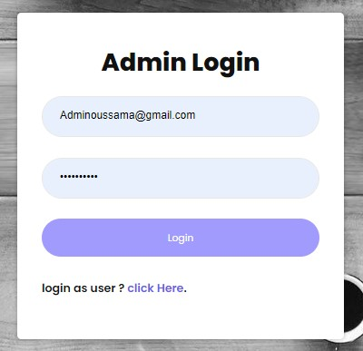
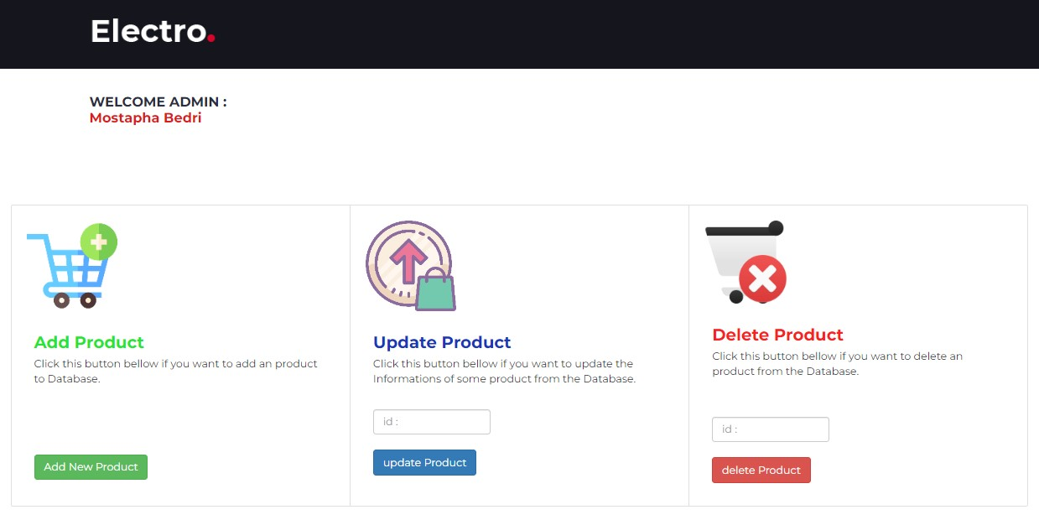
Application
Admin View

Slide 16
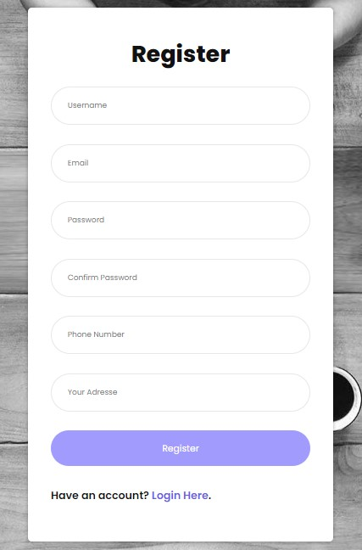
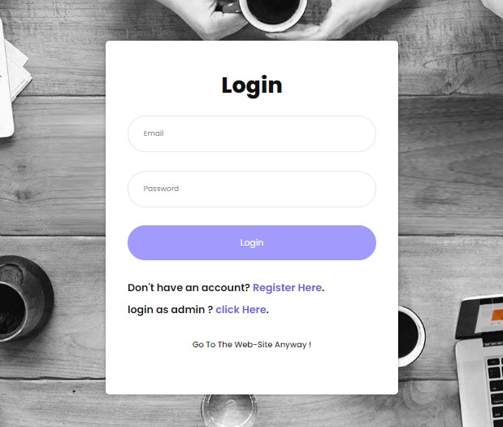
Application
User View
This is the user login interface which enables him to log in so that the system remembers the actions he has done

Slide 17

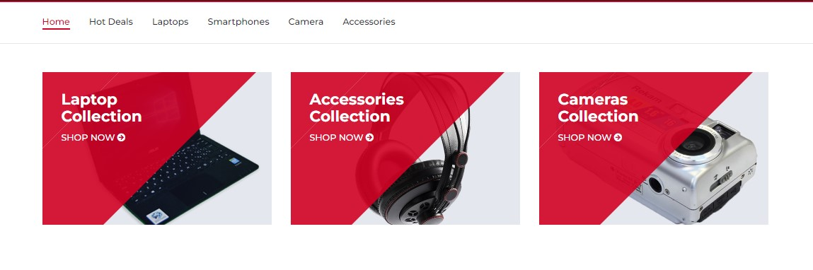
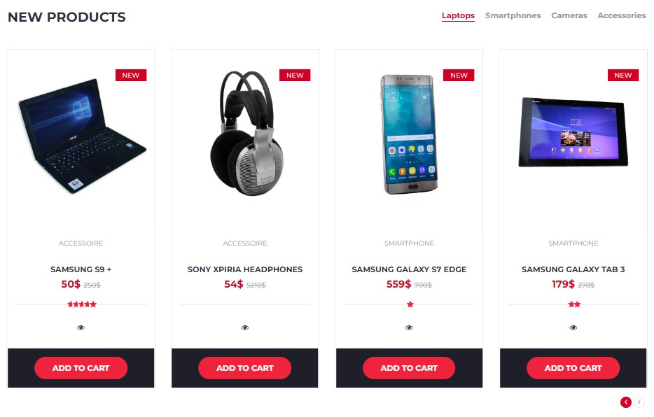
User View
Home Page :

Slide 18
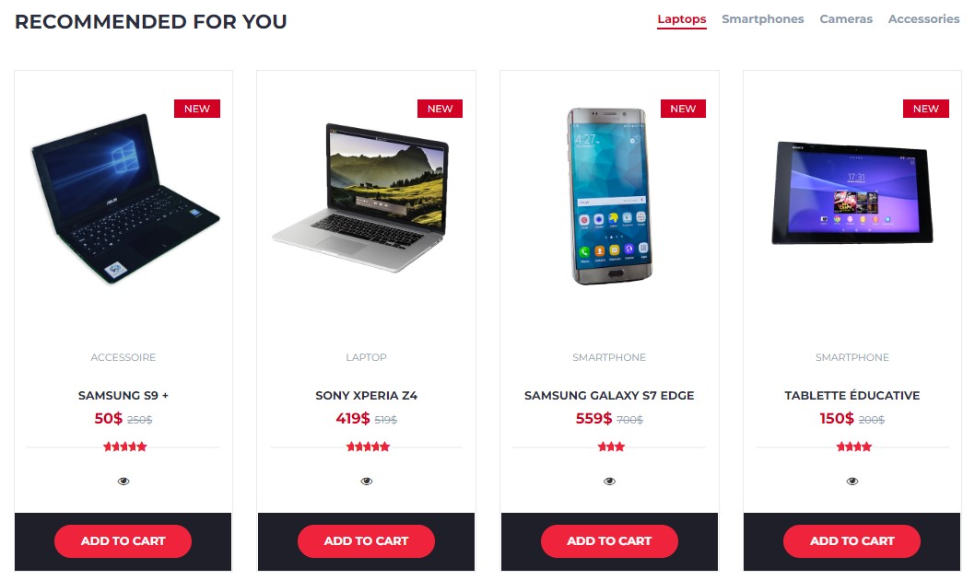
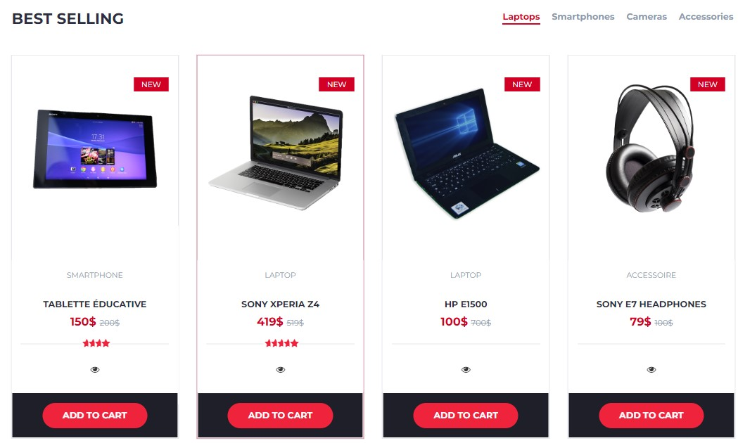
User View
Home Page :

Slide 19
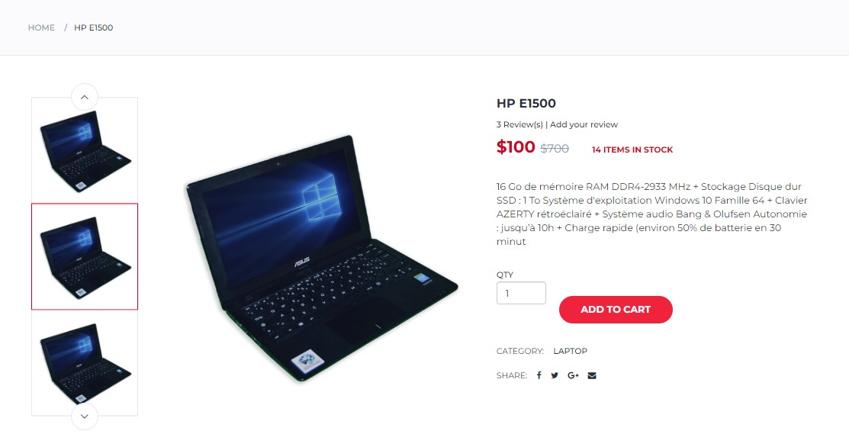
User View
This is the interface of the product Page where you can see detailed information on the product
Product Page :

Slide 20
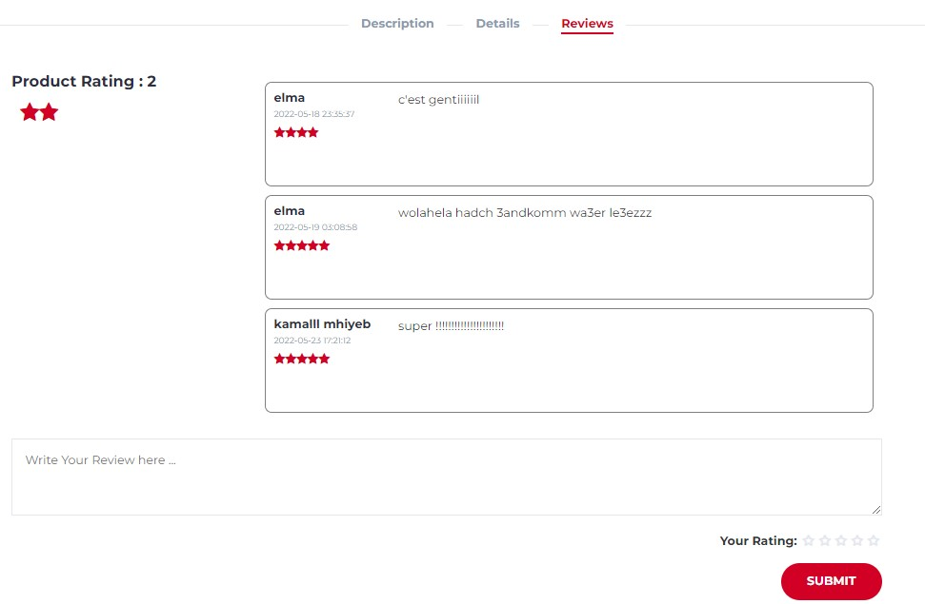
User View
In the same page we can see the reviews submitted by previous users with the possibility to add your personal rating :
Product Page :

Slide 21
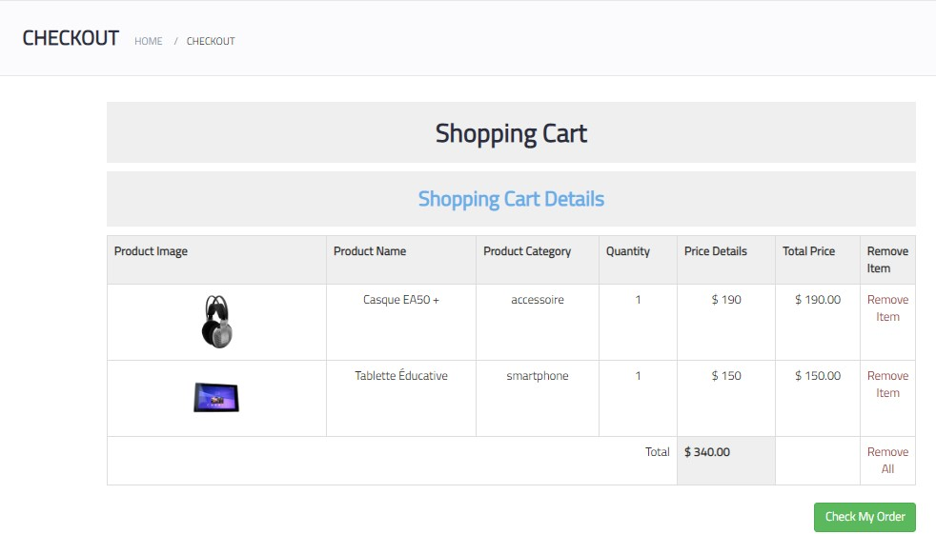
User View
Shows here the products that the customer has added to the shopping cart.
Shopping cart Page :

Slide 22
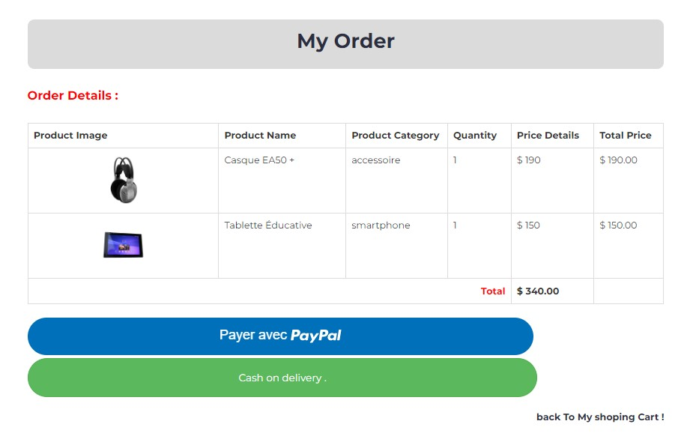
User View
Once the user click on the “check my order” button this page will display:
Product Page :

Slide 23
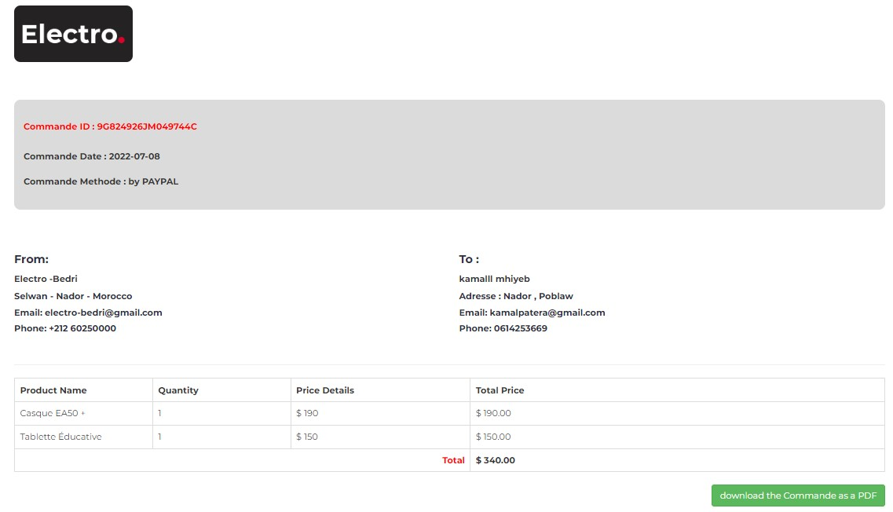
User View
the system takes him to the final page to see the details of his request with the ability to download his order
Product Page :

Slide 24
Conclusion
In this final semester, a full-fledged ecommerce system with different products from different categories for now, waiting for adding real products of our professor workshop and a recommendation system is integrated. We used user to user collaborative filtering which boost the performance of the system.

Slide 25


Thank You !

